Slide 1

PureScript
LA PureScript
Purely Functional Coding
Sean Westfall
Twitter: @alphonse86
Website: fieldsofgoldfish.github.com

Slide 2

Shout out to Carlo Flores, RIP

Slide 3
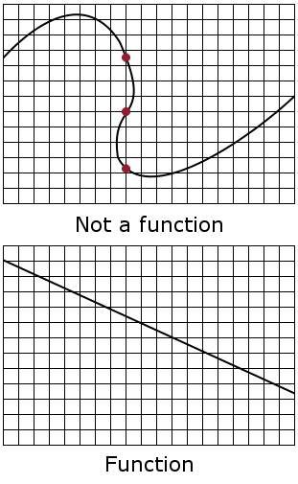
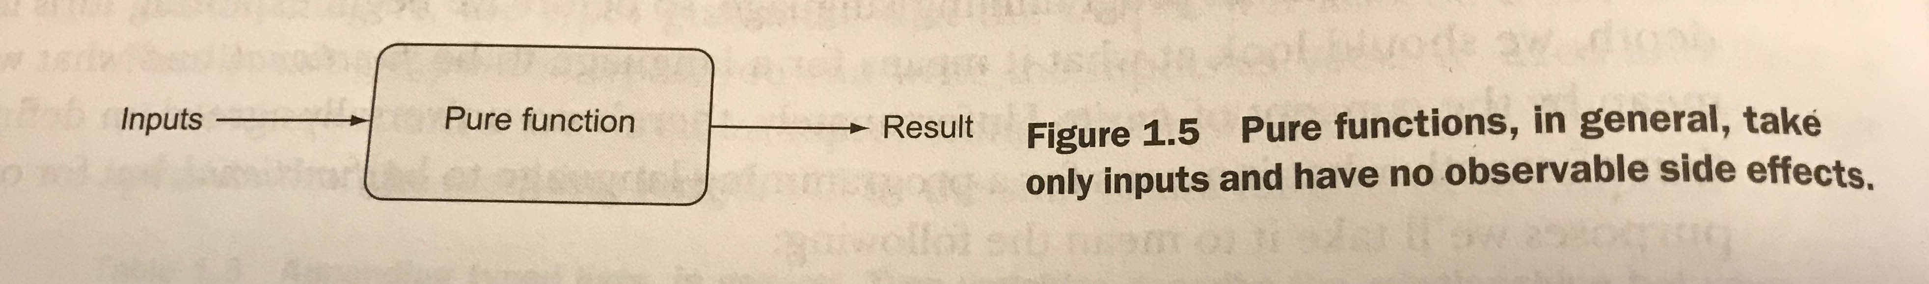
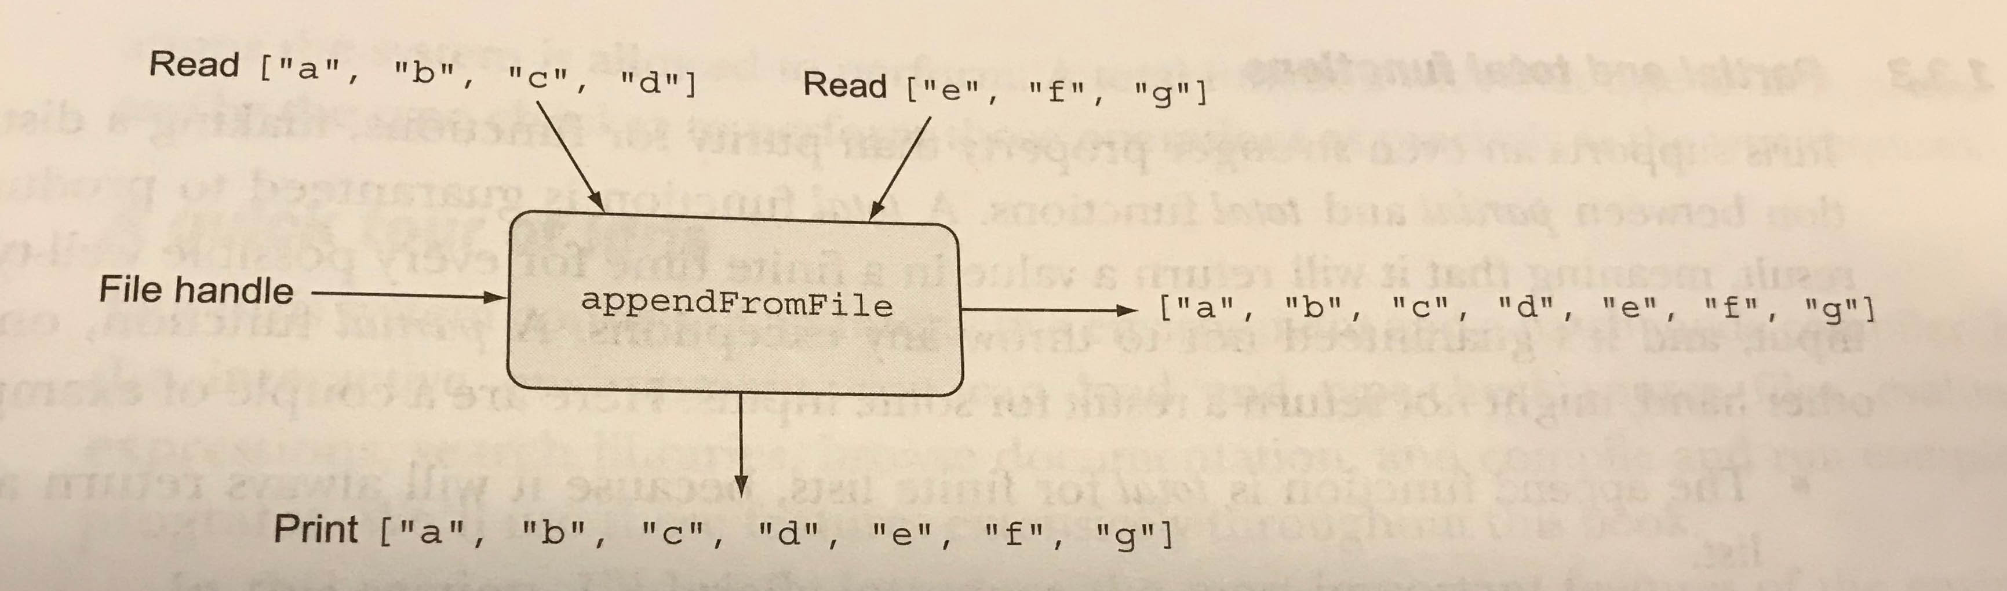
What is `Pure` Functional Programming?

Slide 4
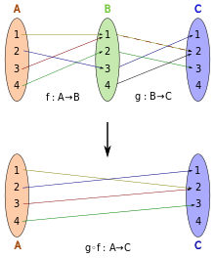
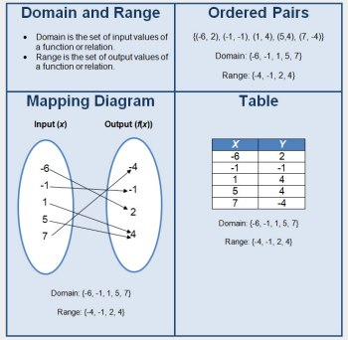

Slide 5
Imperative vs Functional
(define (factorial n)(define (iter product counter)(if (> counter n)product(iter (* counter product)(+ counter 1))))(iter 1 1))
(define (factorial n)(let ((product 1)(counter 1))(define (iter)(if (> counter n)product(begin (set! product (* counter product))(set! counter (+ counter 1))(iter))))(iter)))
(set! counter (+ counter 1))(set! product (* counter product))

Slide 6
Why JavaScript is not Purely Functional
xs.map(first).map(second) → x.map(function(x){ return second(first(x)); })
var state = 0; function first(i){ return state += i; } function second(i){ return i `mod` state; }
var state = 0; function first(i){ return state += i; } function second(i){ return i % state; } [1,2,3,4].map(first).map(second)
[1, 3, 6, 0]
var state = 0; function first(i){ return state += i; } function second(i){ return i % state; } [1,2,3,4].map(function(x){ return second(first(x)); })
[0, 0, 0, 0]

Slide 7
Introducing PureScript

Slide 8
Controlling Effects with Monads

Slide 9
Applicative Functors

Slide 10
`do` notation

Slide 11
TypeScript and the type Maybe<T> = T

Slide 12
Facebook Flow and Maybe & Any Types

Slide 13
Monads in JavaScript
// var ajax = MONAD()
// .lift('alert', alert);
// var monad = ajax("Hello world.");
// monad.alert();
// var maybe = MONAD(function (monad, value) {
// if (value === null || value === undefined) {
// monad.is_null = true;
// monad.bind = function () {
// return monad;
// };
// return null;
// }
// return value;
// });
// var monad = maybe(null);
// monad.bind(alert); // Nothing happens.
/*jslint this */
function MONAD(modifier) {
'use strict';
// Each unit constructor has a monad prototype. The prototype will contain an
// is_monad property for classification, as well as all inheritable methods.
var prototype = Object.create(null);
prototype.is_monad = true;
// monad.js
// Douglas Crockford
// 2016-01-27
// Public Domain
// The MONAD function is a macroid that produces monad constructor functions.
// It can take an optional modifier function, which is a function that is
// allowed to modify new monads at the end of the construction processes.
// A monad constructor (sometimes called 'unit' or 'return' in some mythologies)
// comes with three methods, lift, lift_value, and method, all of which can add
// methods and properties to the monad's prototype.
// A monad has a 'bind' method that takes a function that receives a value and
// is usually expected to return a monad.
// var identity = MONAD();
// var monad = identity("Hello world.");
// monad.bind(alert);

Slide 14
// If MONAD's modifier parameter is a function, then call it, passing the monad
// and the value.
if (typeof modifier === 'function') {
value = modifier(monad, value);
}
// Return the shiny new monad.
return monad;
}
unit.method = function (name, func) {
// Add a method to the prototype.
prototype[name] = func;
return unit;
};
unit.lift_value = function (name, func) {
// Add a method to the prototype that calls bind with the func. This can be
// used for ajax methods that return values other than monads.
prototype[name] = function () {
return this.bind(func, arguments);
};
return unit;
};
unit.lift = function (name, func) {
// Each call to MONAD will produce a new unit constructor function.
function unit(value) {
// Construct a new monad.
var monad = Object.create(prototype);
// In some mythologies 'bind' is called 'pipe' or '>>='.
// The bind method will deliver the unit's value parameter to a function.
monad.bind = function (func, args) {
// bind takes a function and an optional array of arguments. It calls that
// function passing the monad's value and bind's optional array of args.
// With ES6, this horrible return statement can be replaced with
// return func(value, ...args);
return func.apply(
undefined,
[value].concat(Array.prototype.slice.apply(args || []))
);
};

Slide 15
// Add a method to the prototype that calls bind with the func. If the value
// returned by the func is not a monad, then make a monad.
prototype[name] = function () {
var result = this.bind(func, arguments);
return (result && result.is_monad === true)
? result
: unit(result);
};
return unit;
};
return unit;
}

Slide 16
Functors

Slide 17
Applicative Functors

Slide 18
Monoid

Slide 19
Monads

